Slide 1
Malignant comment Classification
By :----Ankita Srivastava

Slide 2
Introduction
People use social media as a platform to express their opinions and views.
With it comes the risk of cyber abuse and harassment, which can put an end to people expressing themselves and giving up on seeking opinions.
To protect the users from cyberbullying, every organization should have an automated system in place to identify such malicious comments and suitable actions against the same.

Slide 3
Objective
We have undertaken this project to classify the comments made by different users on social media platforms, like the Instagrame, Twitter in this case, to build a model that is capable of detecting and classifying these Message into various classes like ‘Malignant’, ‘Highly malignant’, ‘Rude’, ‘Threat’, ‘Abuse’ and ‘Loathe’.

Slide 4
Preprocessing of Data
We have performed the following preprocessing on the data:
Removed punctuations
Removed the stop words
Stemming and lemmatization
Applied counter vectorizer

Slide 5
DATA MODELING
Problem Transformation Method
We used the Random Forest classifier for classification.
We used this classifier, since it is suitable for classification with discrete features

Slide 6
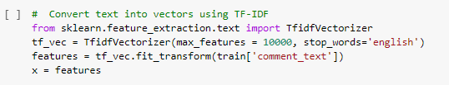
TF ID VECTORIZER
TFIDF works by proportionally increasing the number of times a word appears in the document but is counterbalanced by the number of documents in which it is present. Hence, words like 'this', 'are' etc., that are commonly present in all the documents are not given a very high rank

Slide 7
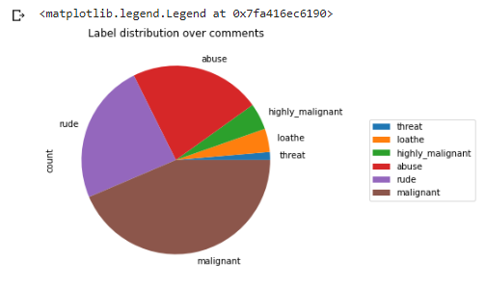
DATA VISUALIZATION

Slide 8
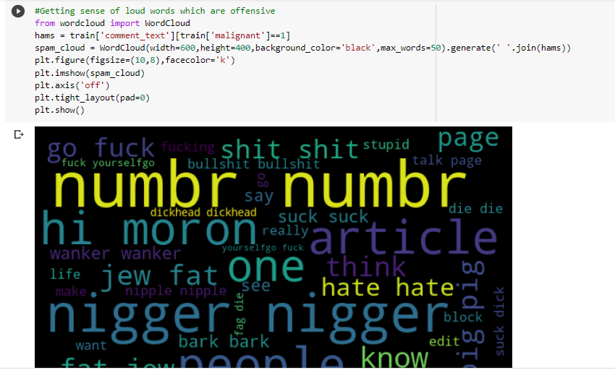
World cloud
Word Cloud is a data visualization technique used for representing text data in which the size of each word indicates its frequency or importance. Significant textual data points can be highlighted using a word cloud. Word clouds are widely used for analyzing data from social network websites.

Slide 9
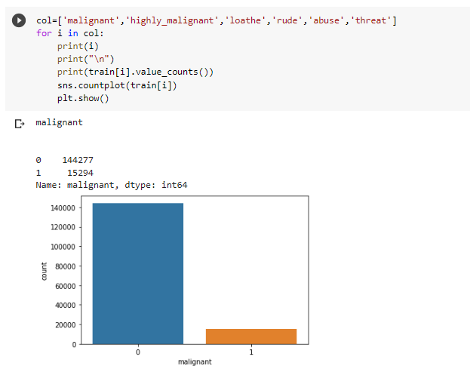
DATA VISUALIZATION

Slide 10
ANALIYSIS OF RESULT
Upon testing the models, on the malignant comments we have analyzed the following:
Most of the comment text are up to 264 characters long.
Most of the comments fell under the “toxic” class.

Slide 11
CHALLENGES
Collection of USABLE DATA – although we extracted over 62893130 records, only 43537267 records were usable among them.
Cleaning the data – Due to the character limit comment contain a lot of short forms which are different to classify using bag of words model.

Slide 12
References
Wikipedia : https://en.wikipedia.org/wiki/Multi-label_classification
jigsaw-toxic-comment-classification-challenge
https://www.javatpoint.com/nlp
• https://www.youtube.com/watch?v=w3coRFpyddQ&list=PLZoTAELRM XVNNrHSKv36Lr3_156yCo6Nn&ab_channel=KrishNaik
• https://stackoverflow.com/questions/35861482/nltk-lookup-error
• https://www.pythonanywhere.com/forums/topic/31724/
• https://github.com/keon/CodeGAN/issues/1

Slide 13
Thank You

